Slide 1
26
GROUP
Fraud Data Analytics Project
By Wang Weishi, Li Dongheng,
Gao Peiyan, Mak Lam, Xie Ning

Slide 2
01
Fraud Data Analytics Methodology

Slide 3
Case Background Profile
Background
1. According to SMALL bank’s report, more than 80 thousand credit card digital
payments records are reported of being stolen in a monthly basis.
2. We are the Financial Fraud Analysis team that are assigned by the SMALL bank to
develop a fraud detection model to prevent similar fraud cases happening in the future.
3

Slide 4
Case Background Profile
Background
3. The variables available for each transaction:
The distance from home where the transaction happened.
The distance from last transaction happened.
Ratio of purchase price transaction to median purchase price.
Is the transaction happened from same retailer.
Is the transaction through credit card.
Is the transaction using PIN number.
Is the transaction an online order.
Is the transaction fraudulent.
4. This is a labeled dataset.
4

Slide 5
Scope of Fraud Data Analytics
Detect frauds according to transaction records and evaluate the correlation between fraudulent behavior and provided transaction information.
01
Use the developed model for credit card fraud detection to identify future fraudulent behaviors related to SMALL bank credit cards using corresponding transaction information in each transaction entry.
02
5

Slide 6
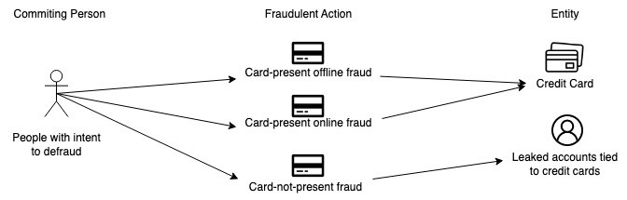
Fraud Scenario Identification
Card-present offline fraud: Copied or stolen Credit cards used in offline transaction.
Card-present online fraud: Copied or stolen Credit cards used in online orders.
Card-not-present fraud: Leaked credit card numbers with personal information used in online orders, leaked accounts tied to credit cards, abuse by contracted merchants.
6

Slide 7
Data Analytics Strategies
Specific Identification Strategy
Stolen or copied Credit Card are used in both online and offline transaction.
Leaked user accounts tied to credit cards are used in online transaction.
Data Interpretation
Any fraud transactions using PIN number.
Any fraud transactions that are online orders.)
Any fraud transactions that are from repeat retailers.
Fraud transactions that has high ratio of purchased price transaction to median purchase price.
7

Slide 8
02
Exploratory Data Analysis

Slide 9

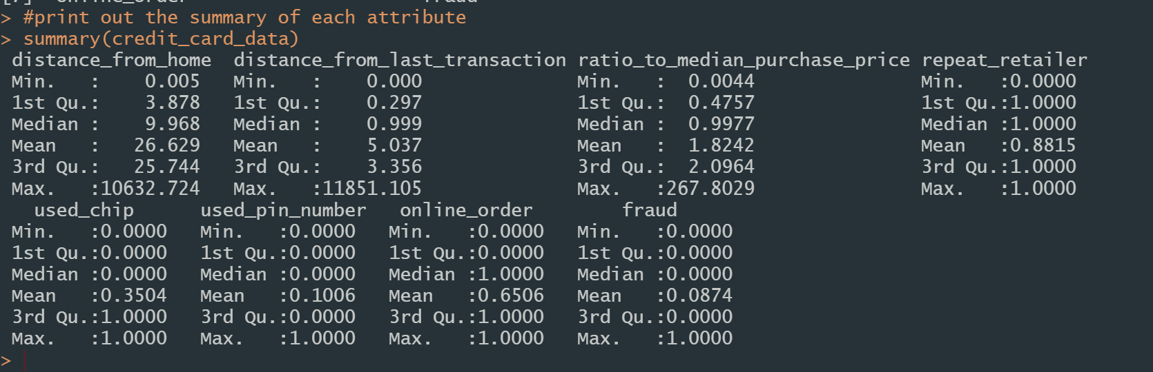
EDA - Summary
8 attributes
1,000,000 observations
9

Slide 10
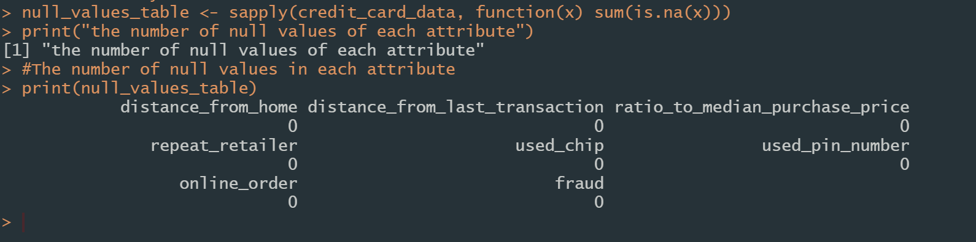
EDA - Missing Values
No null value in this dataset
10
Notes:
In the summary table in the previous slide, it shows that there is no negative value in each attribute

Slide 11
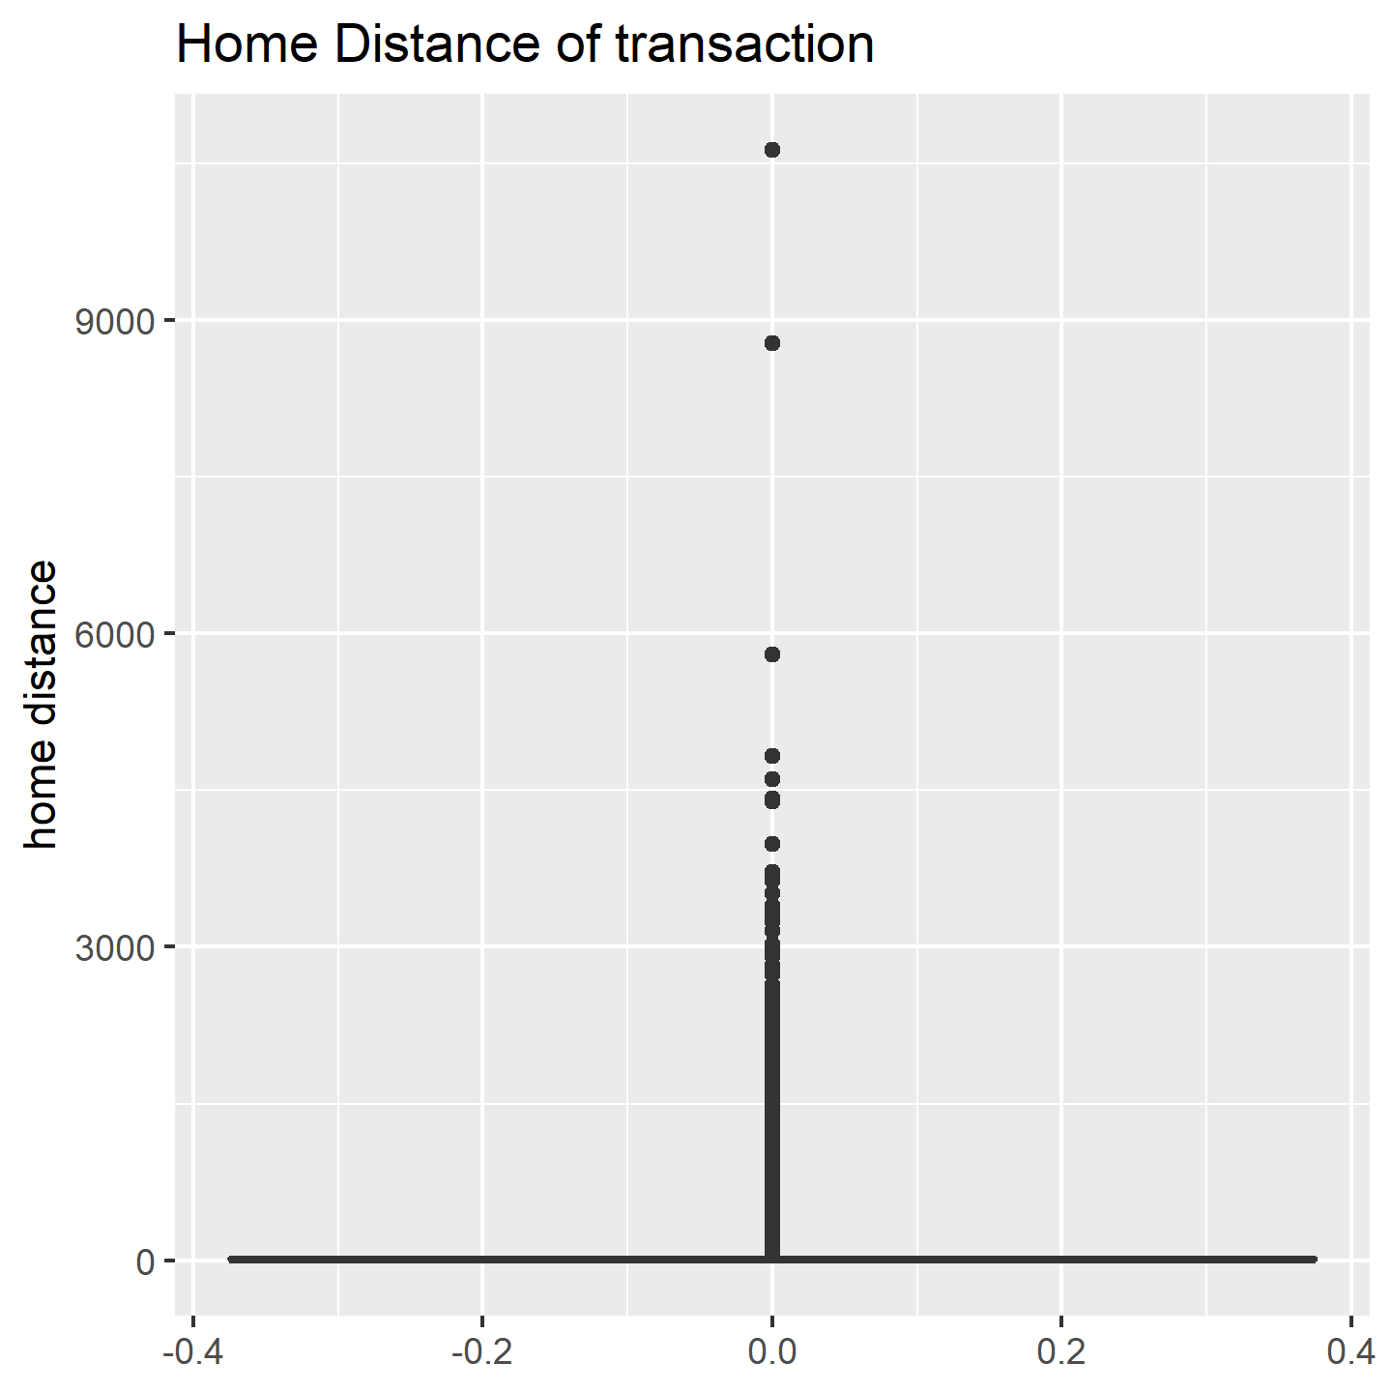
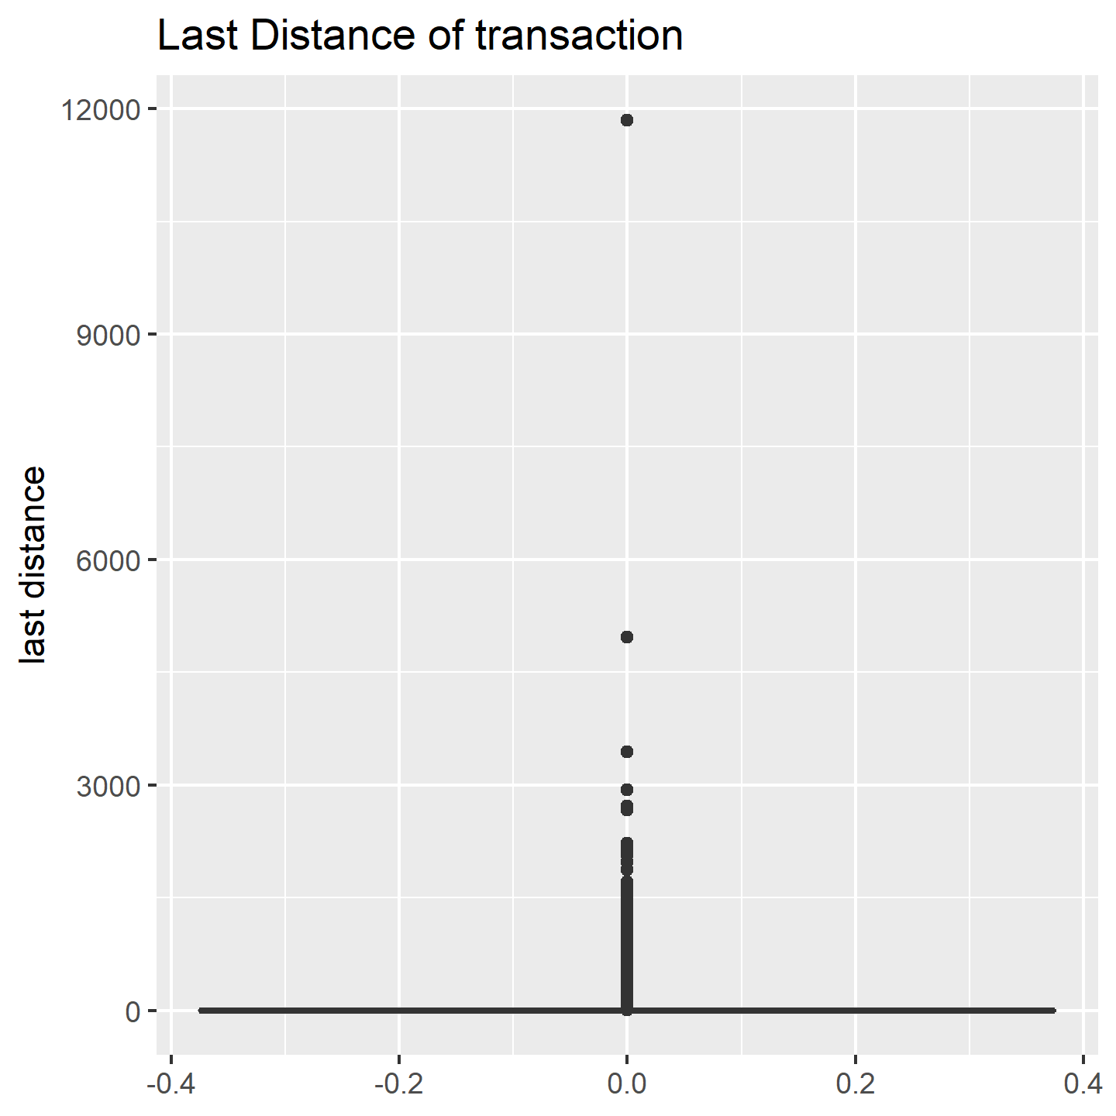
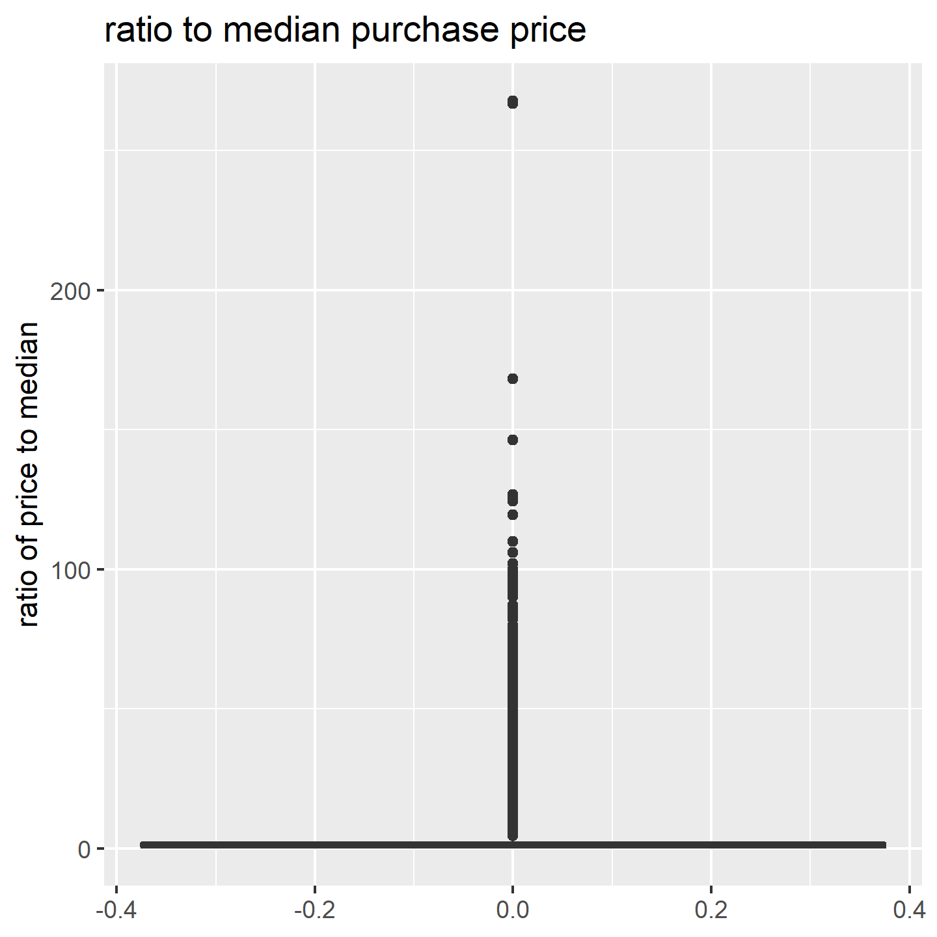
EDA – Outlier Analysis
No negative value in every attribute
Individual extreme cases
11
Notes:
In the summary table in the previous slide, it shows that there is no negative value in each attribute

Slide 12
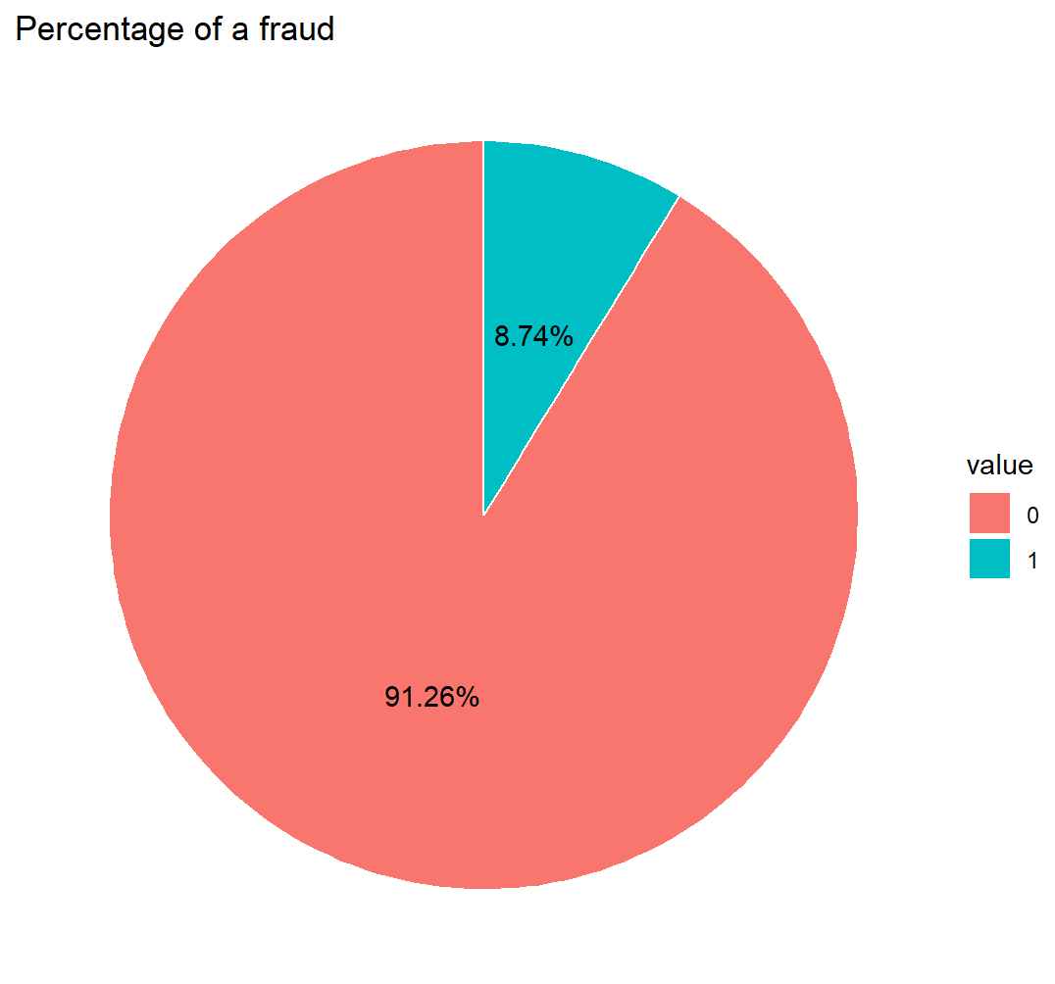
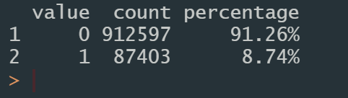
EDA – Univariate Analysis
This is an unbalance dataset
12

Slide 13
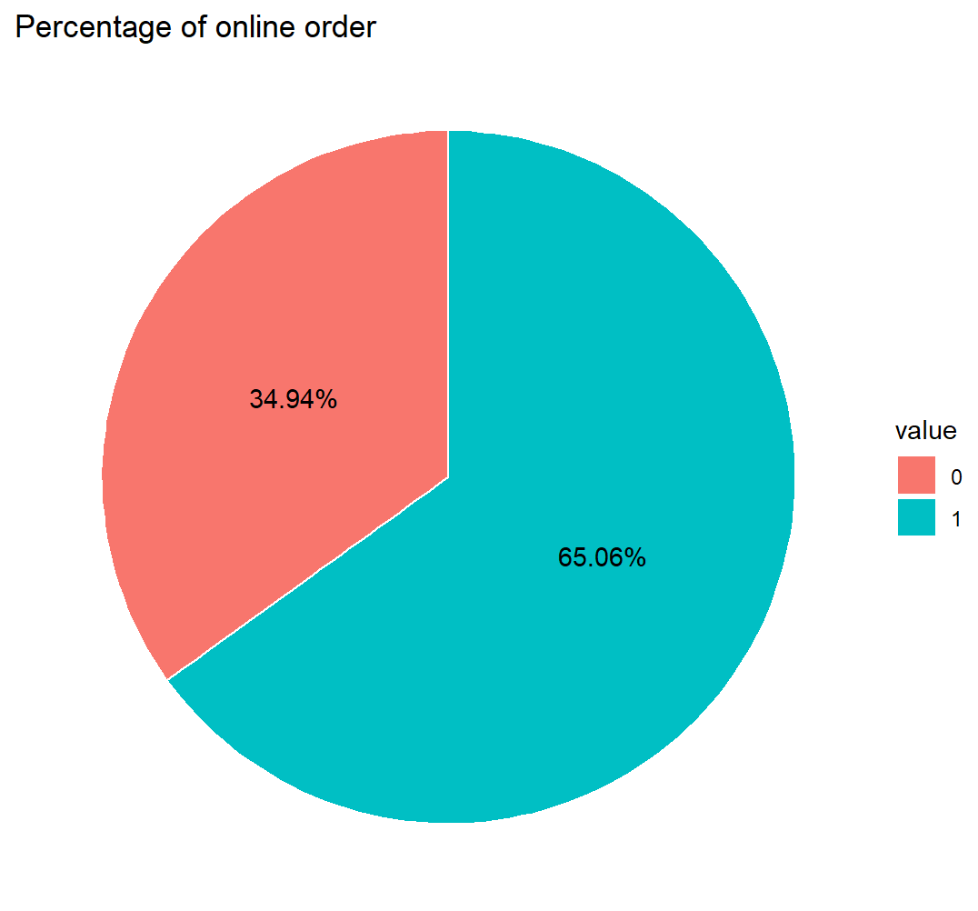
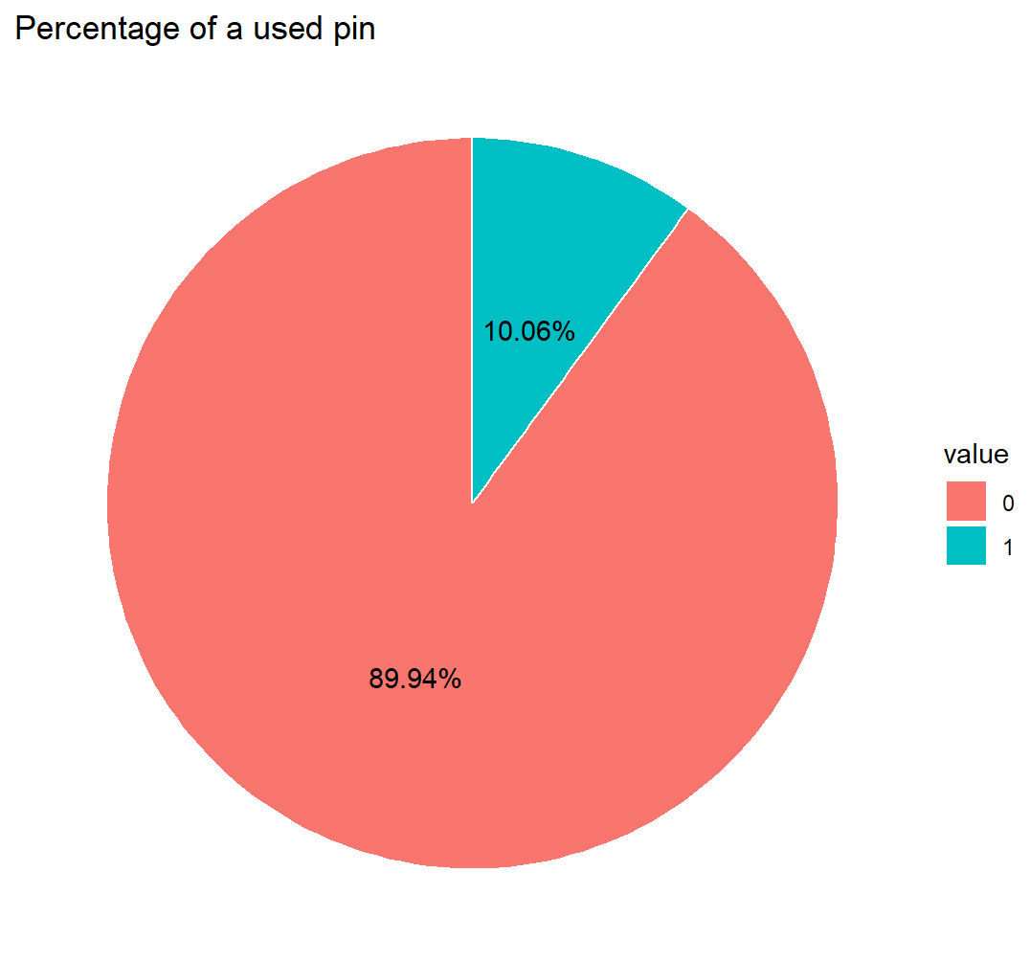
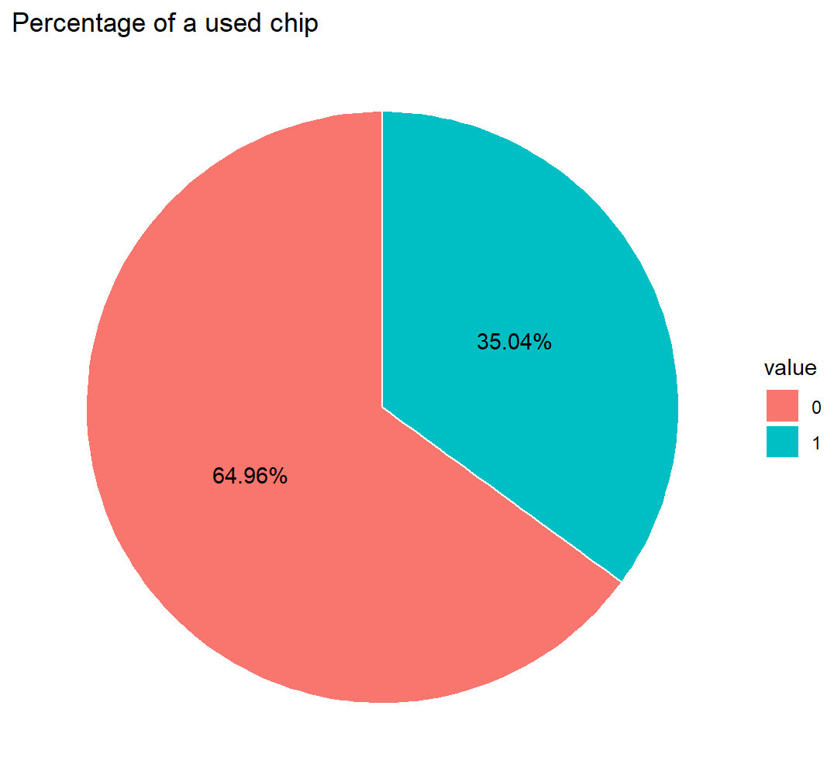
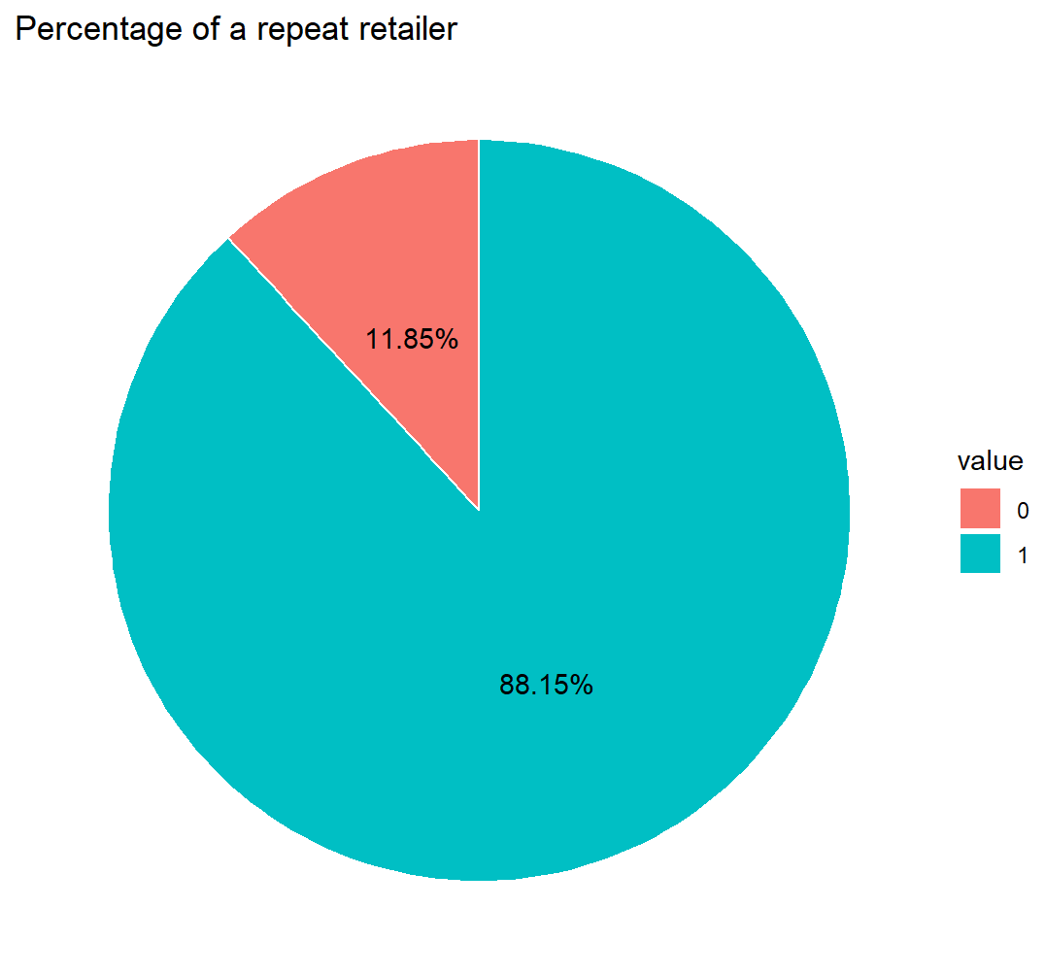
EDA – Univariate Analysis
0: not used pin
1: used pin
0: offline order
1: online order
0: not used chip
1: used chip
0: not repeated retailer
1: is repeated retailer
13
Notes:
The majority transactions in this dataset is online orders.
Most transactions do not use pin

Slide 14
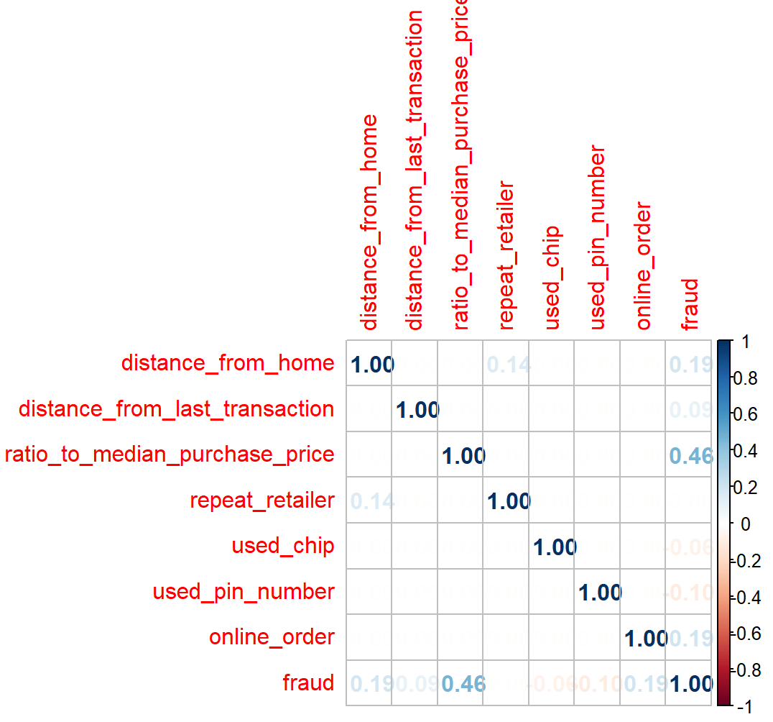
EDA – Correlation Heatmap
Correlation to fraud
ratio_to_median_purchase_price: high (0.46)
distance_from_home: low (0.19)
online_order: low (0.19)
14
Notes:
The purchase price is the dominant factor that decides if the cases is a fraud cases.
While there are also some attributes like distance from home, online order, etc has a slighter effect on the decision

Slide 15
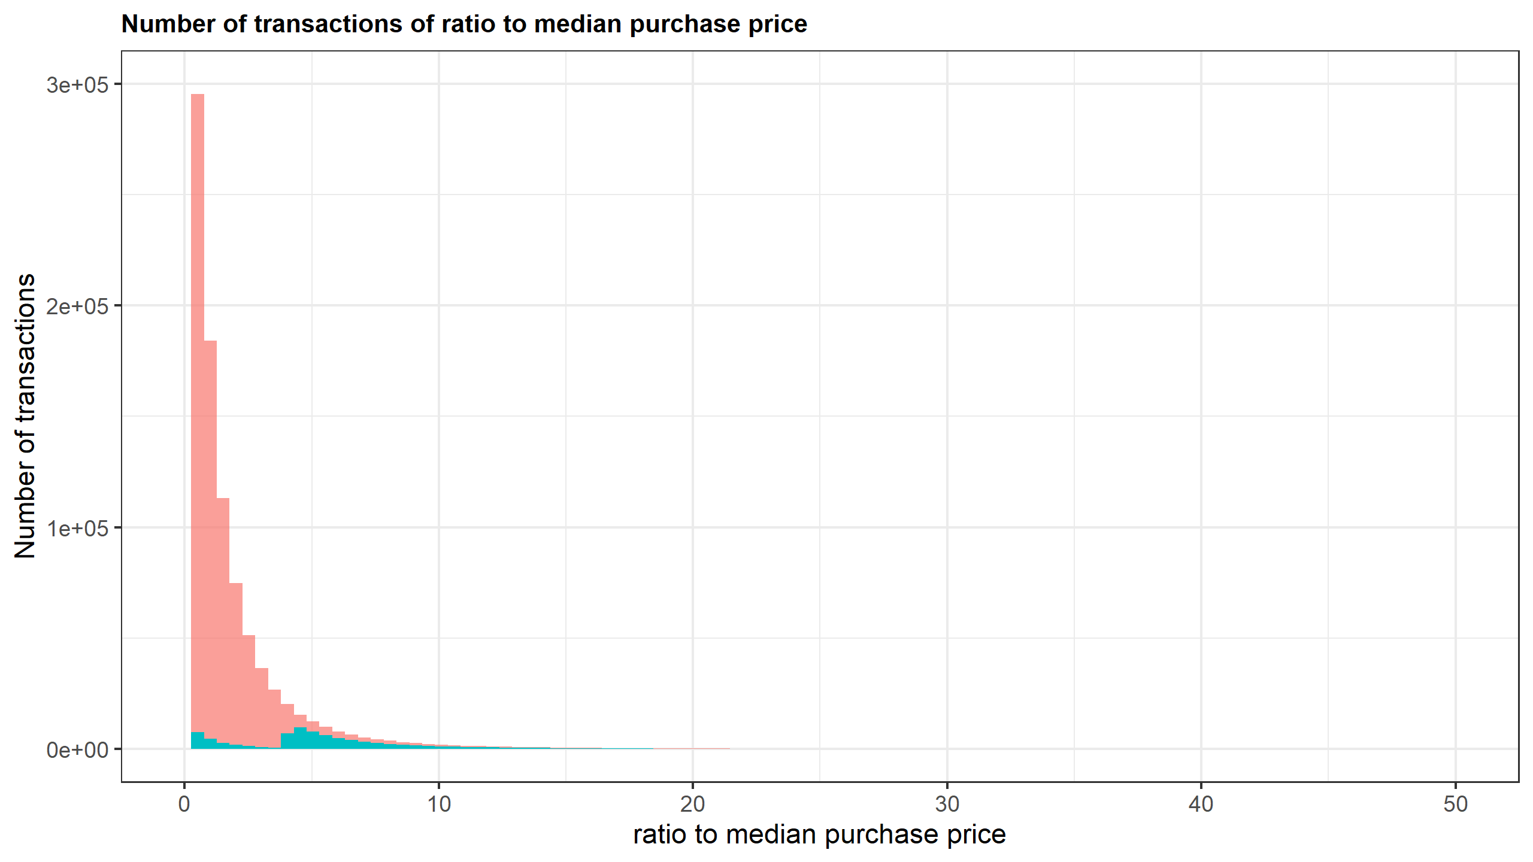
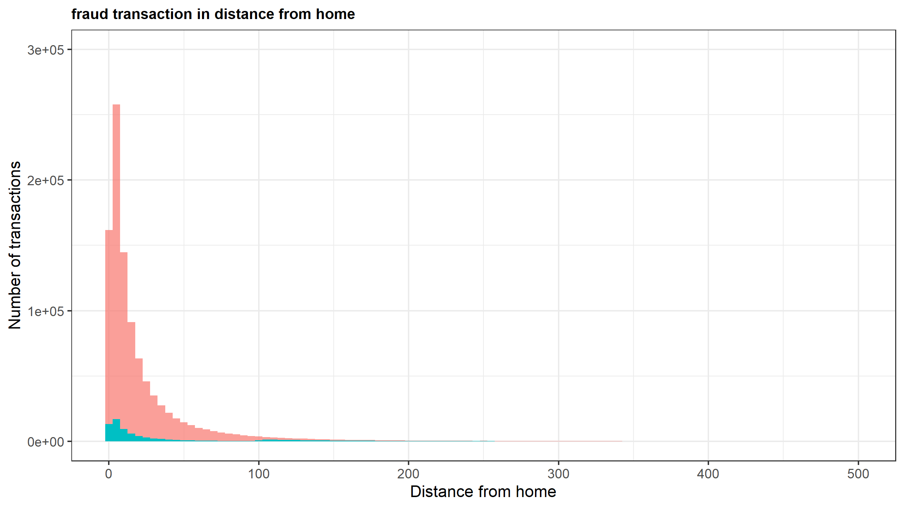
EDA – Bivariate Analysis
Red: normal transactions
Blue: fraudulent cases
15
Notes:
Both normal and fraud cases have a small value in distance from home.
The pattern of fraud cases generally follows the normal cases.
There is a feature in this ratio to median purchase price.
With the normal cases mainly centralized in values that is around one, the fraudulent cases can be divided into two parts: small ratio part and high ratio part.
The percentage of fraud cases is high when the ratio to median purchase price is also high.

Slide 16
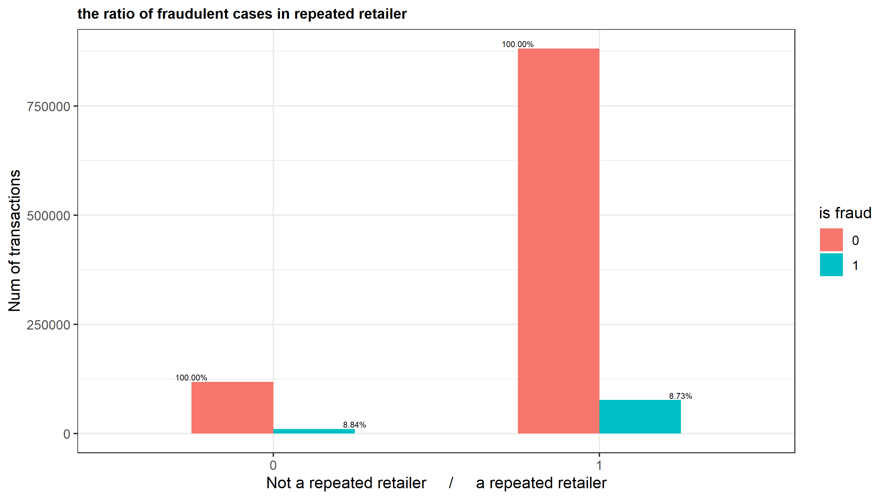
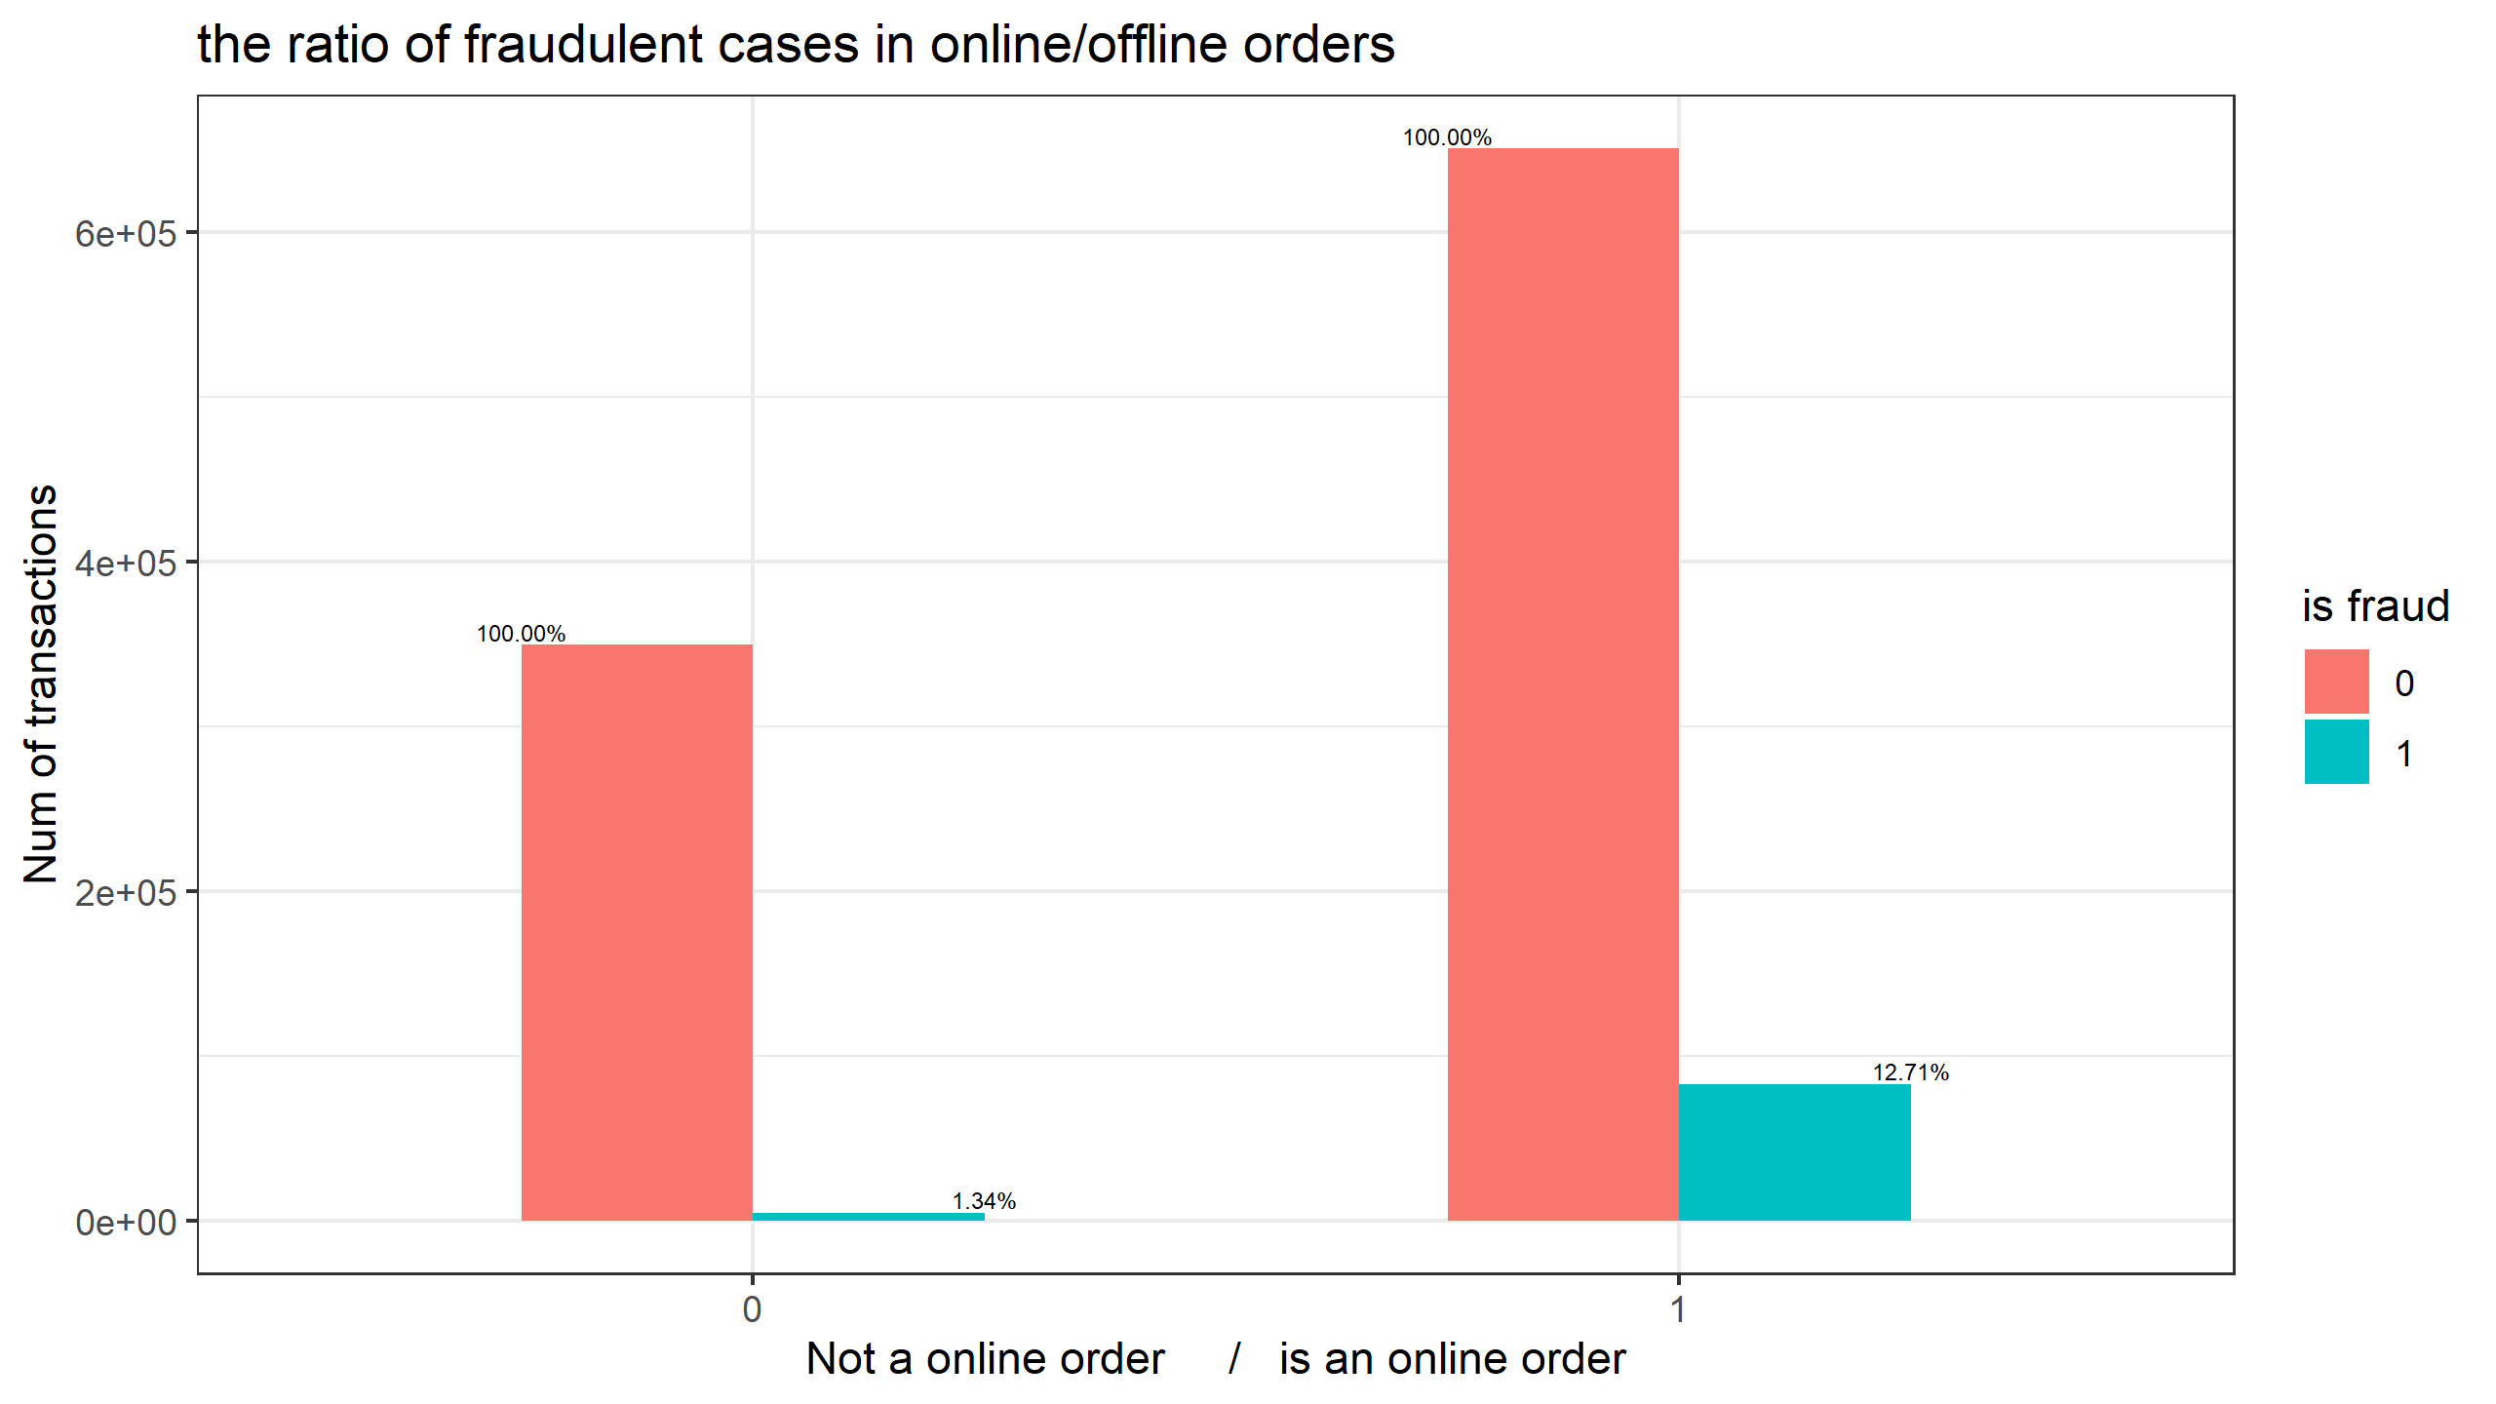
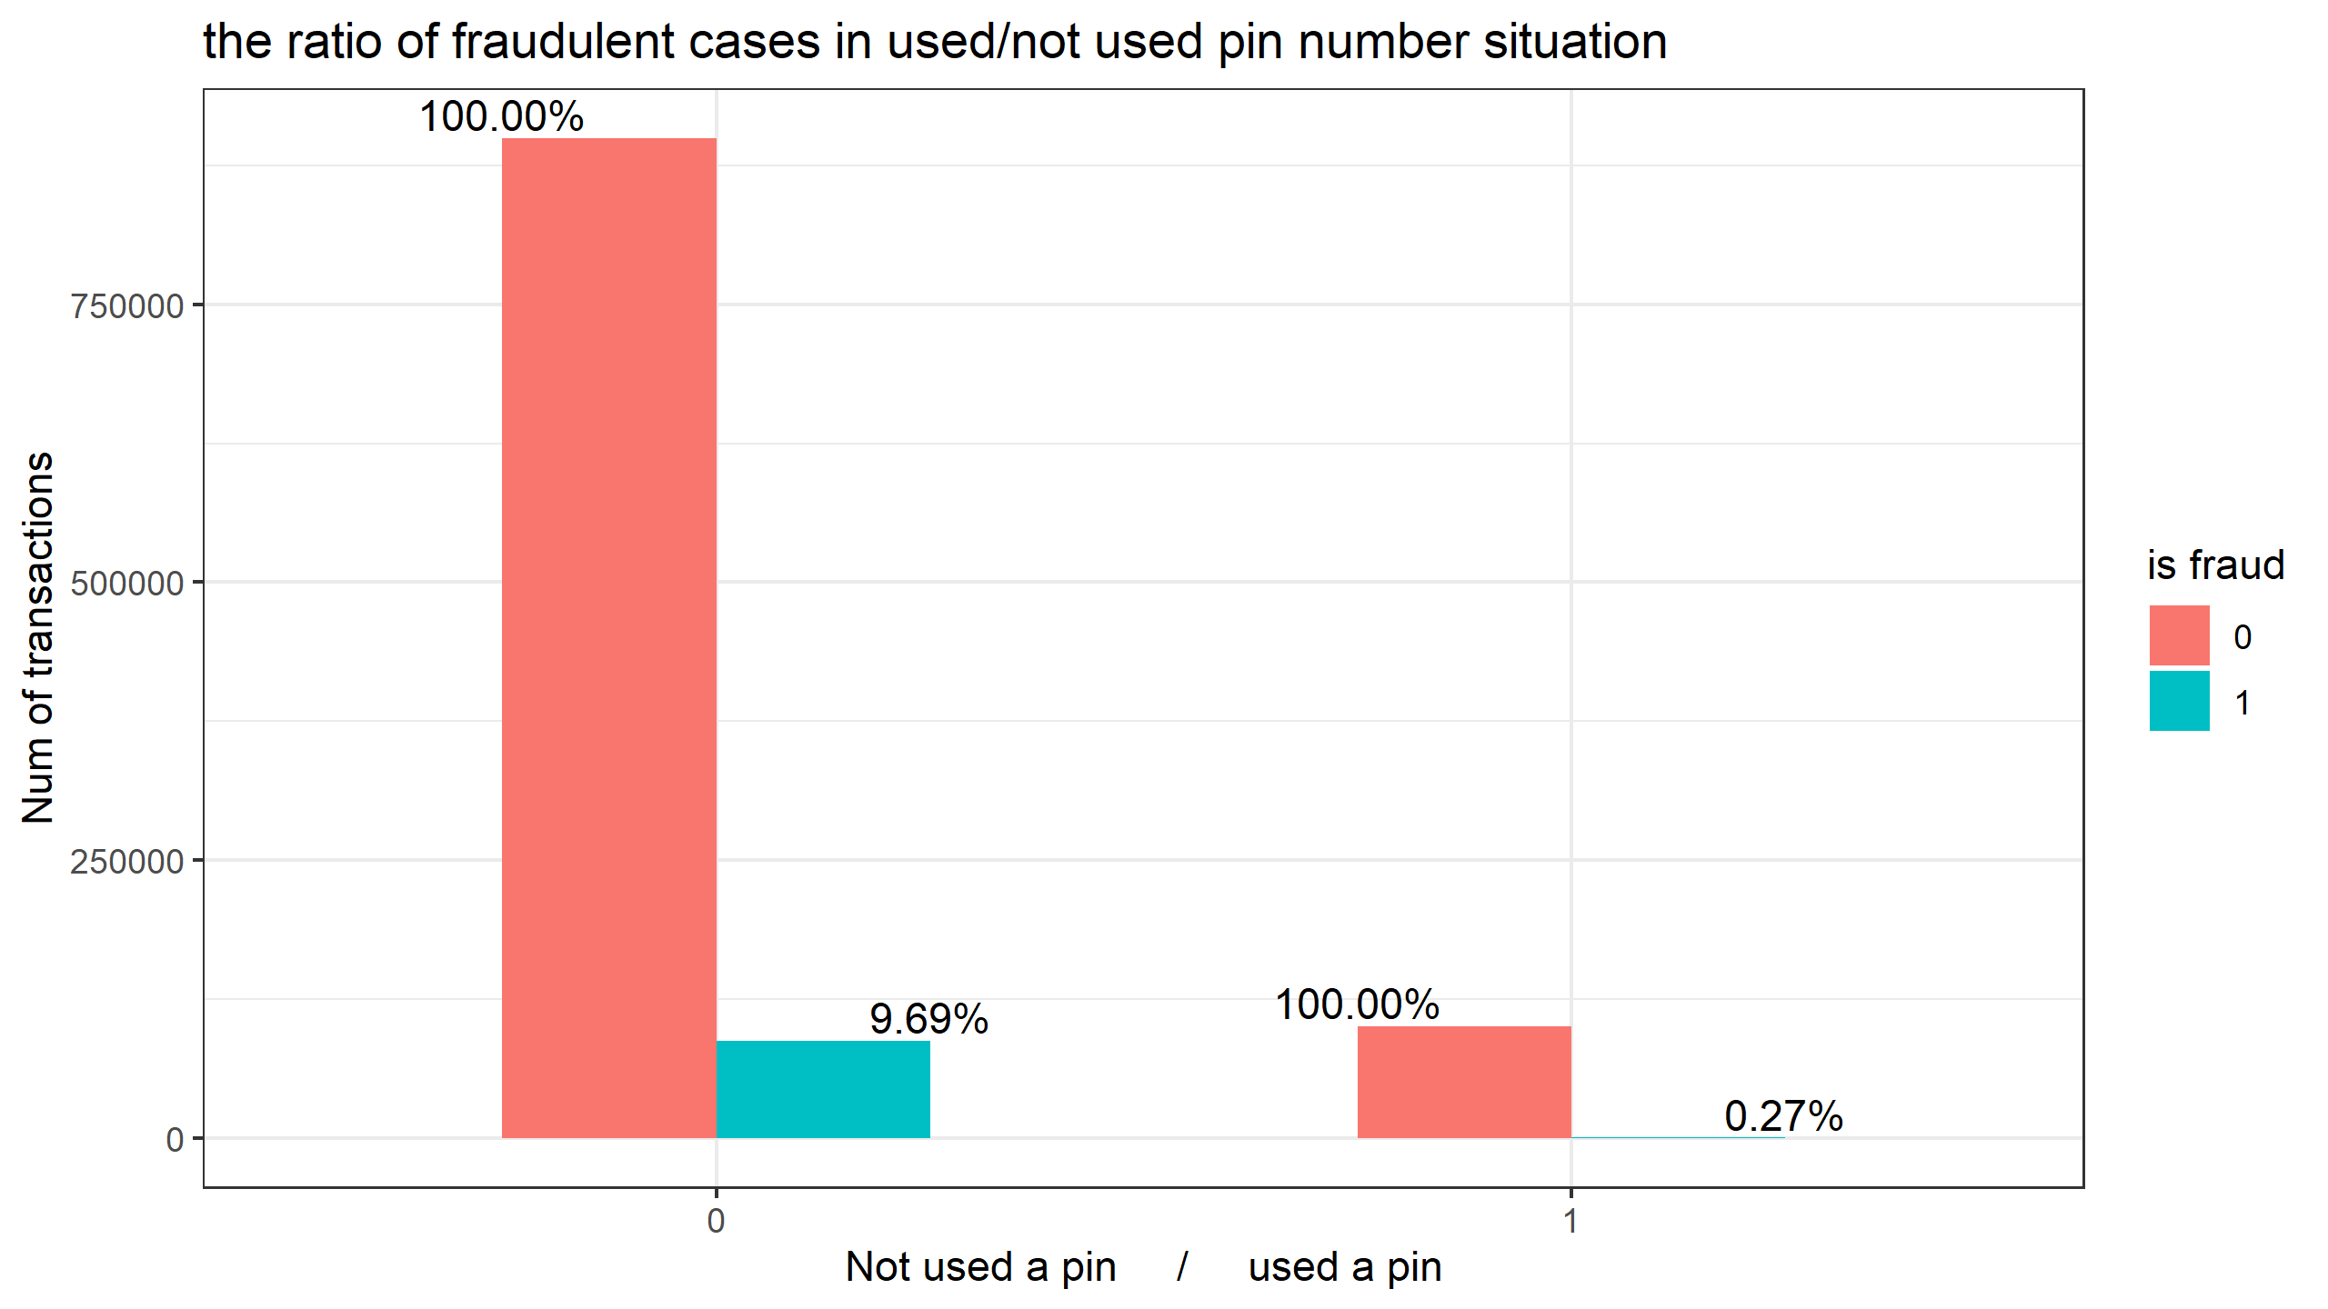
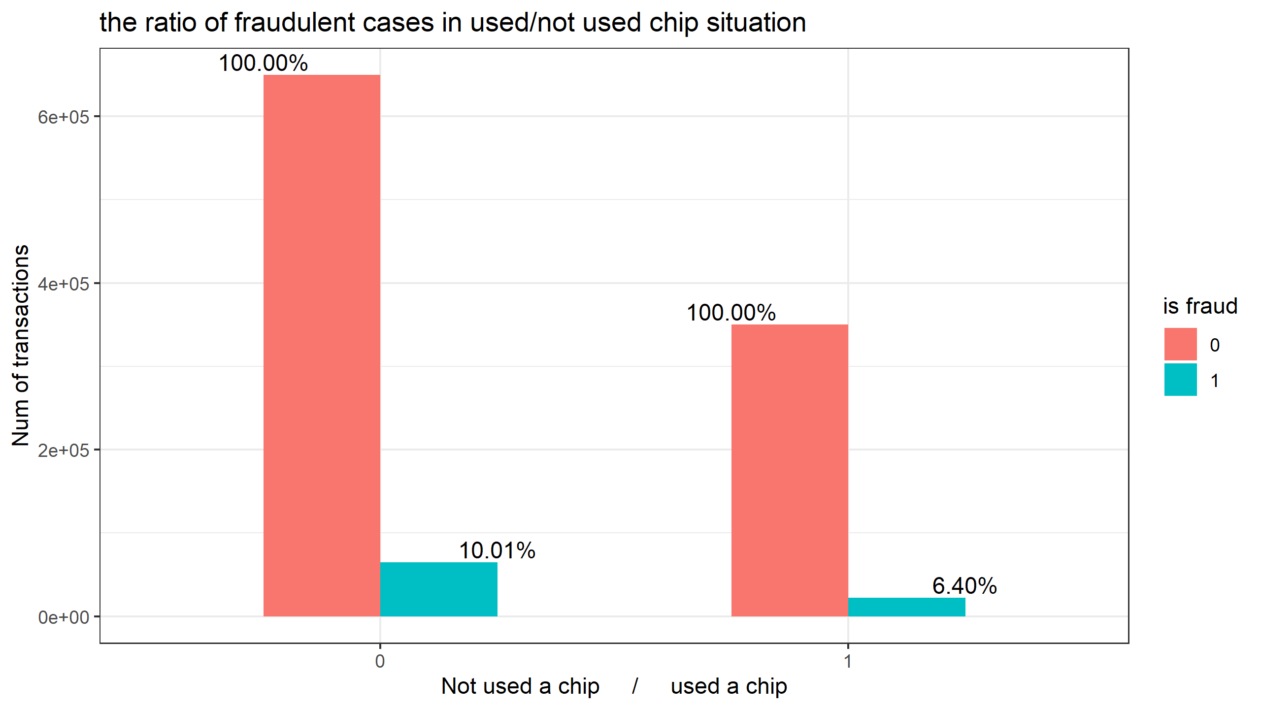
EDA – Bivariate Analysis
8.73%
12.71%
8.84%
1.34%
12.71% is fraud
1.34% is fraud
9.69%
10.01%
0.27%
6.40%
16
Notes:
The fraud percentage of online order is a lot higher than offline order.
The fraud percentage of used pin cases is a lot lower than not used pin cases.
Repeated retailer is not relevant to fraud.

Slide 17
03
Data Analytic

Slide 18
Starting from Dataset
Characteristic
Low-dimension
Large-size
18
Notes:
Here comes to the data analytic part As seen from EDA, we have large dataset with only a few features

Slide 19
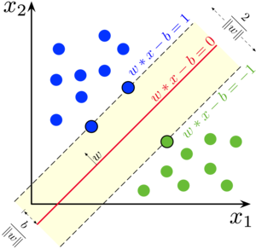
SVM
Able to capture the nonlinear structure by kernel transformation
Hyperparameters chosen:
C : 0.01 (due to time complexity concerns)
Kernel: Gaussian
Gamma:0.5
Resilient to outliers
Require feature scaling, might require label balancing as well
19
Notes:
Here the first model we try is SVM.
It has the merit of capturing nonlinearity, also resilient to outliers.
Besides, it is distanced based method require feature scaling and perhaps label balancing,
so we choose small C due to time complexity concerns and gaussian kernel with gamma 0.5

Slide 20
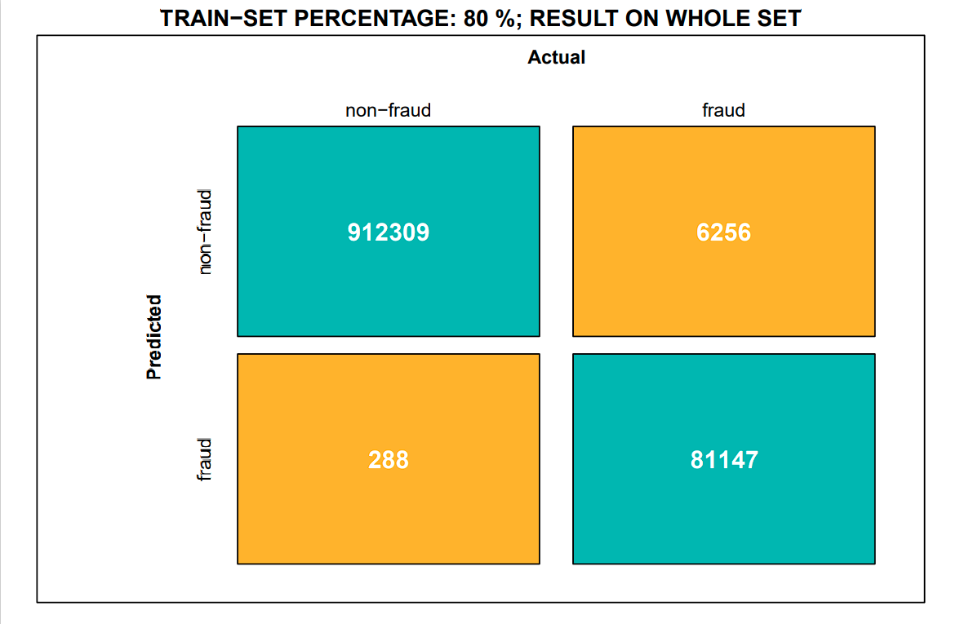
SVM RESULT – without downsampling
Precision
Recall
F1
Accuracy
Kappa
0.996
0.928
0.961
0.993
0.958
20
Notes:
We first use the whole unbalanced dataset, split training set by the given proportion and build the model based on that, and evaluated on the whole set.
As seen results are good, except recall still have space for improvement

Slide 21

SVM RESULT – without downsampling
Precision
Recall
F1
Accuracy
Kappa
0.997
0.892
0.941
0.99
0.936
21
Notes:
As we shrink the training set proportion, the performance gets slightly worse.

Slide 22
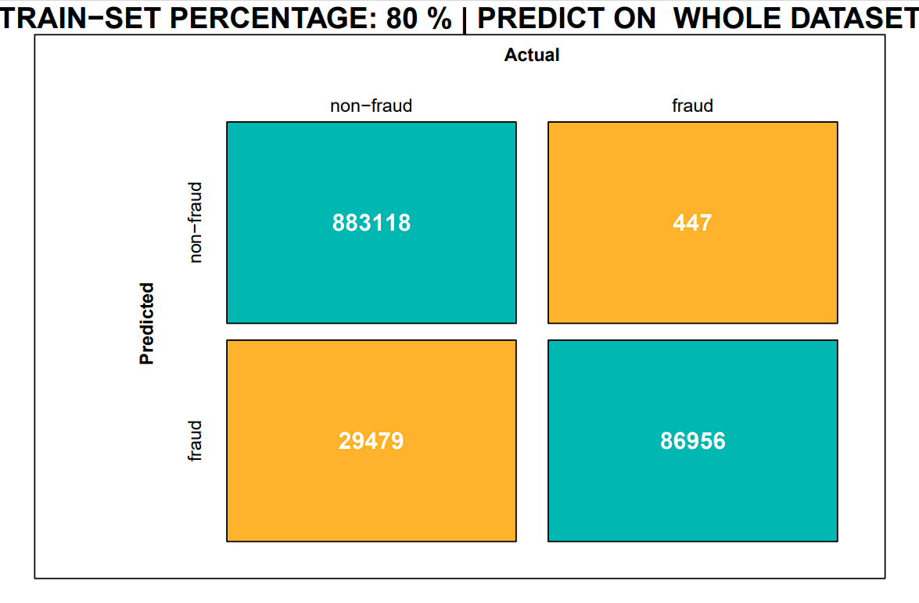
SVM RESULT – with downsampling
Precision
Recall
F1
Accuracy
Kappa
0.747
0.995
0.853
0.97
0.837
22
Notes:
We rebuild the model, by first downsampling the data to balance the labels, split from this downsampled set to get training data and build the model, still evaluate on the whole set.
Here we see the trade off between label balancing and downsampling, as we have higher recall, meaning the model is more capable of capturing fraud cases, but also much lower recall, meaning the model gets too arrestee that lots of normal cases are classified as fraud.

Slide 23
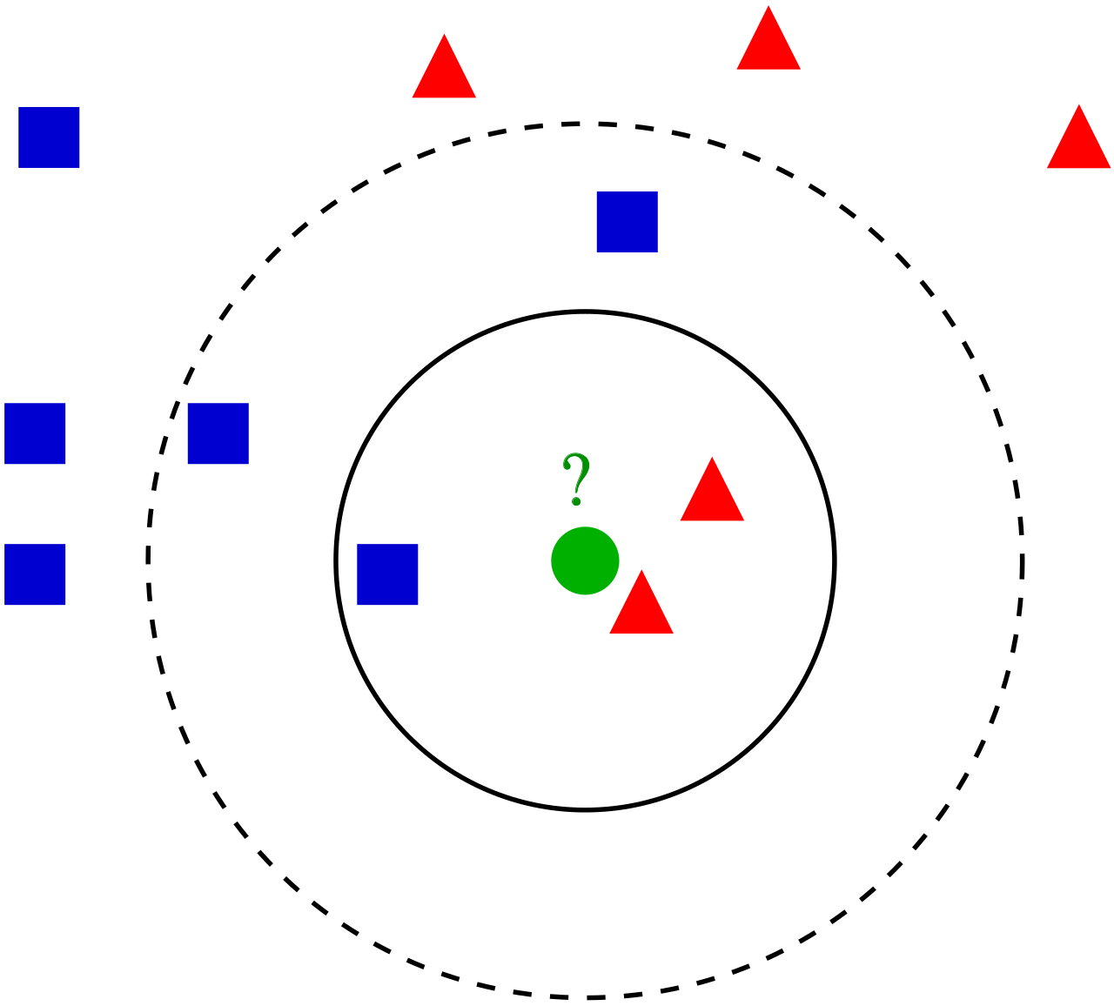
K-NN
Quite high accuracy on clustering works
Performs better on low-dimension dataset
23
Notes:
However, one important assumption about svm is that data is separable by a hyperplane or a boundary which might not hold true in practice, hence we think knn might be a better alternative as it trains faster, its more suitable for clustering work, also perform better on low dimensional dataset.

Slide 24
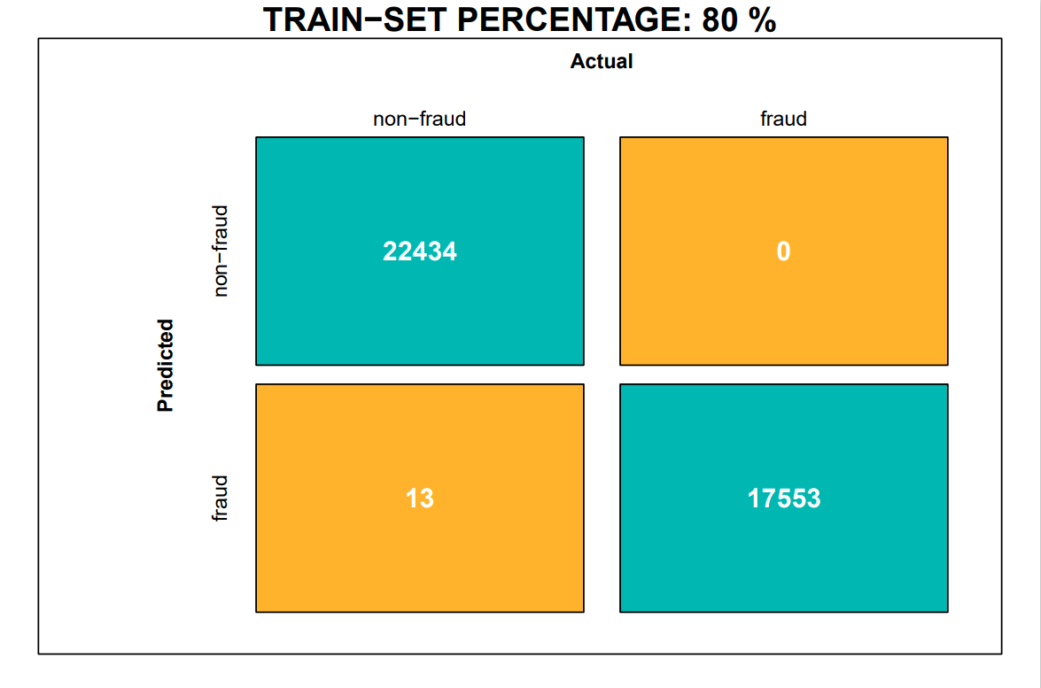
K-NN RESULT
Precision
Recall
F1
Accuracy
Kappa
0.999
1
1
1
0.999
24
Notes:
Like before we rescale and downsample the dataset, and then do the train test split, and here evaluated on the test size, results is quite satisfactory, at least better than svm.

Slide 25
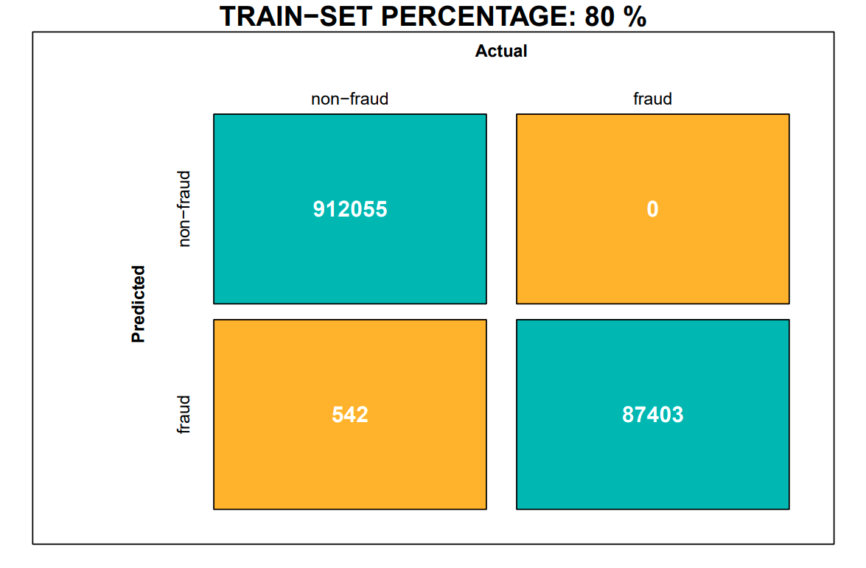
K-NN RESULT
Precision
Recall
F1
Accuracy
Kappa
0.994
1
0.997
0.999
0.997
25
Notes:
Here we evaluate it on the whole set, result still good except precision drops down a little bit.

Slide 26

K-NN RESULT
Precision
Recall
F1
Accuracy
Kappa
0.994
1
0.997
0.999
0.997
26
Notes:
Even if we push down the training proportion, result does not get worse except only a few more false positive.
We can see knn already gives us fairly good prediction performance. However if we want to explore more about each feature importance and their inductiveness, we should try tree-based method instead.

Slide 27
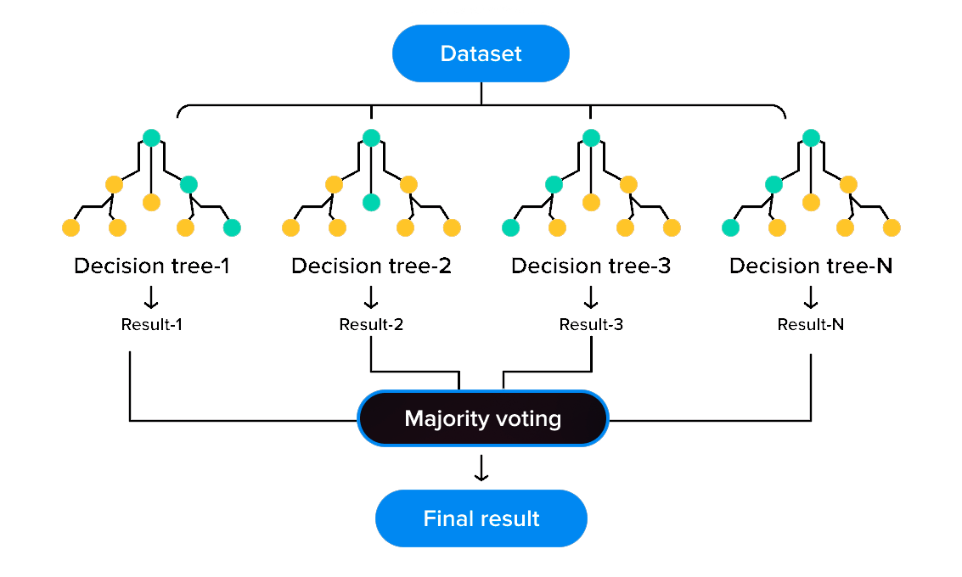
Tree Based Model – Random Forest
27
Notes:
One widely used model is random forest, which bootstrapping instances to build multiple decision trees and vote for the result. Thanks to some characteristics of this model, we do not need to do scaling or balancing sampling to the dataset. And as we thought, the model performs amazingly well.

Slide 28

RANDOM FOREST RESULT
Precision
Recall
F1
Accuracy
Kappa
1
1
1
1
1
28
Notes:
The performance is nearly perfect, but what about the problem we just mentioned? Let’s try to provide only a small part of data and see what happens:

Slide 29

RANDOM FOREST RESULT – 2
Precision
Recall
F1
Accuracy
Kappa
1
1
1
1
1
29
Notes:
Alright, still amazing. Because random forest is not sensitive to the missing part of the data, it can extract valuable features from few instances. Now we have a model with high accuracy, what do we need next?

Slide 30
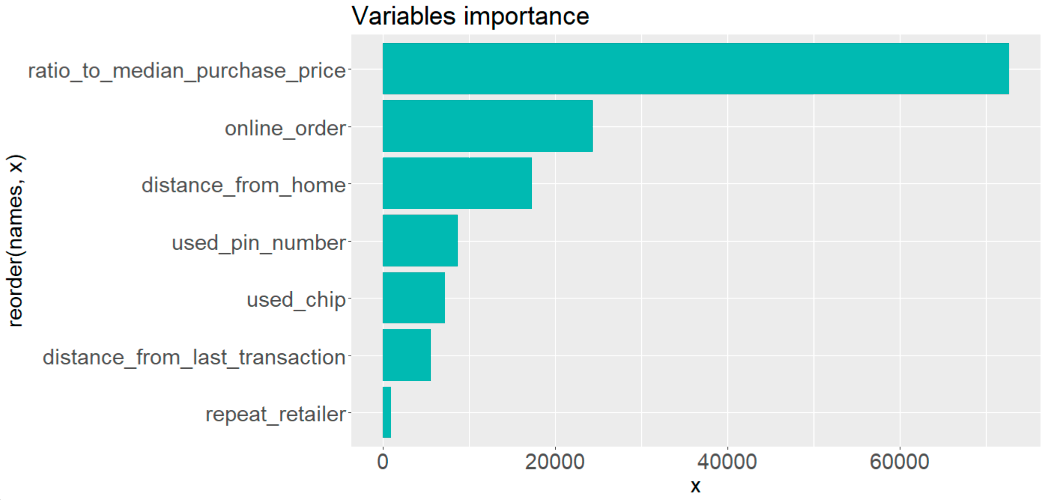
ATTRIBUTES IMPORTANCE
30
Notes:
Check the attributes importance exported from the model, we can verify the correlation of the variables mentioned in the EDA process. But how do we explain the attributes importance?

Slide 31
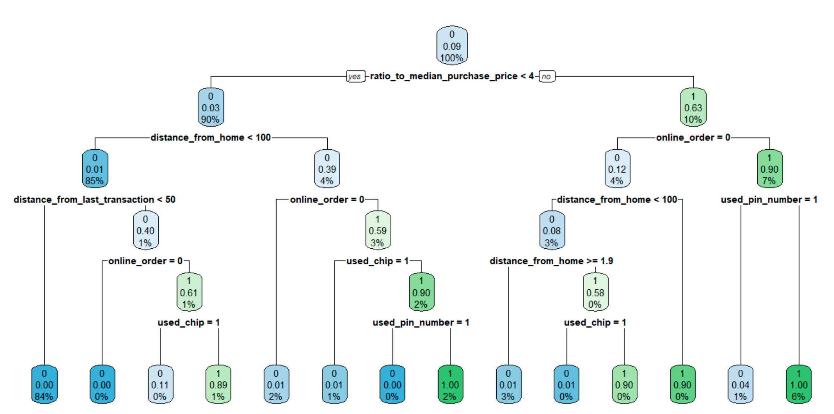
FRAUD ANALYSIS
31
Notes:
We then used decision tree - an algorithm with high interpretability - to help us explore the relationship between these attributes and the fraud cases. In another words - how do these attributes effect the results of classification. To simplify this diagram a bit, we get this.

Slide 32
FRAUD ANALYSIS
ratio_to_median_purchase_price | online_order | distance_ from_home | used_pin_number | used_chip | distance_from_last_transaction
≥4 | 0 | <1.9 | X | 0 | X
≥4 | 0 | ≥100 | X | X | X
≥4 | 1 | X | 0 | X | X
＜4 | 1 | ≥100 | 0 | 0 | X
＜4 | 1 | <100 | X | 0 | ≥50
32
Notes:
Summarize the five rules to fraud cases, they should be merchant abuse, stealing, deception, leaked account and leaked pin number. Then we can use these rules to give our customers some advices and to add some restrictions in our system to decrease the fraud rate.

Slide 33
04
Non-data analytic element

Slide 34
Non-data analytic element
Red Flag
The ratio of the current transaction amount to the median is too high
The transaction type is online shopping
The location of the transaction is too far from the user's address
No payment password was used during the transaction
Both transactions occurred at the same merchant i.e. repeated retailer
34

Slide 35

Non-data Analytic Elements
1. Firstly, we should check each link within the bank to confirm whether any link has the risk of information leakage. In information management, we should clarify the responsibilities of each department and person so that they can restrict each other and avoid the disclosure of information.
2. Next, we should improve the information management system to ensure the reliability of the technology and leave traces of every step of information modification so that there is evidence to trace when problems occur in the future.
3. Improve the professionalism and ethics of merchants to prevent them from being able to obtain other people's information from daily purchases and commit credit card theft.
Controls
35

Slide 36
Suggestions on Prevent
Credit Card Service
strictly check the applicant's information when opening an account to ensure that it is true and valid, verify the applicant’s credit record to avoid fraudulent behavior such as malicious overdraft.
amount of each transaction
Warn of larger transaction amount, increase the audit of such transactions.
Online Payment
It is necessary to improve the security verification of online payment by requiring the trader to enter a password and perform information identification for identity verification when making online payment. And for the payer, raise awareness of the safety precautions is very important. When they are paying the bill, they need to confirm the safety of the website and the information of the retailer.
36

Slide 37
Suggestions on Prevent (Con’t)
Location of the Transaction
Add the function of detecting the location of the transaction to warn of transactions with a large difference between the location of the transaction and the address of the account holder. Strengthen the verification of the identity of the transaction to prevent credit card theft abroad.
Limitation to Authorize
For transactions that can be authorized to merchants for no-pin payment debit, the amount of debit that can occur in the future can be limited to reduce the degree of damage when fraud occurs.
Lost Card
Cardholders who discover that their credit cards have been lost or stolen should immediately report the loss to their banks to prevent further losses.
37

